Slide 1
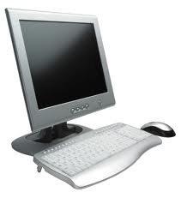
Digital Rights
By: Ryan Scott Atkinson McKenna Elisabeth Backhaus

Slide 2
What?
Digital rights are rights and regulations on the computer.
You need to follow these rules when on the internet.
Everyone has the right to use this technology.

Slide 3
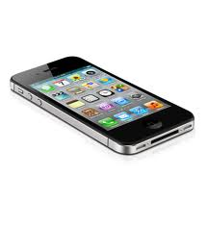
Where?
In a school.
At home.
They can be anywhere.
They can be found in organizations in the AUP.

Slide 4
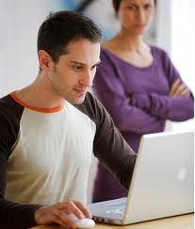
Why?
We want the internet to be safe.
So we can have the rights, behavior and freedom of being able to use technology.
The AUP shows examples of rules and regulations of using the technology.

Slide 5
How?
Digital rights work through the AUP.
Some AUP organizations make it.

Slide 6
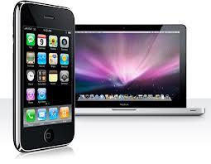
When?
When you are using a computer. Or any other type of electronic device.
Communicating with others through a electronic device.

